Slide 1


Slide 2
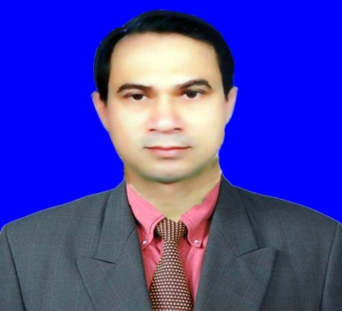
Introduction
Milton Biswas
Sinner Asst. Teacher
Ramkanai High Academy.
Brahmanbaria.

Slide 3
Lesson
ENGLISH 2nd paper parts of speech
Class –Six
Date:07-09-2013
Time:50 min.

Slide 4
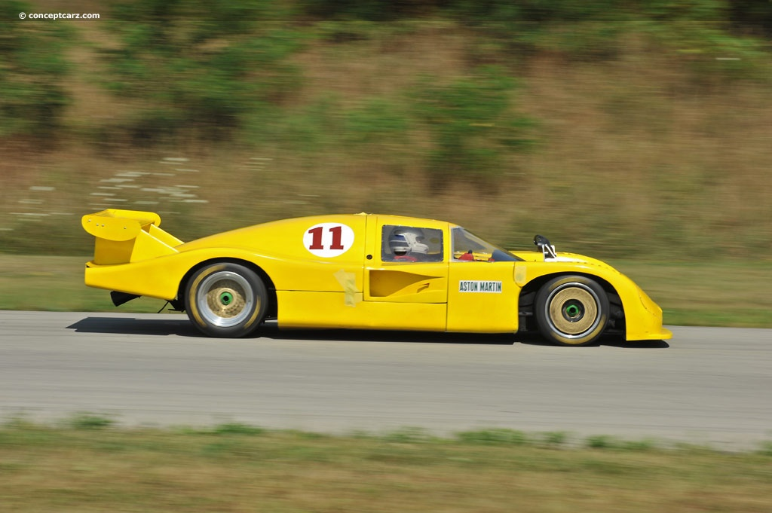
Wheel
or parts of a car

Slide 5
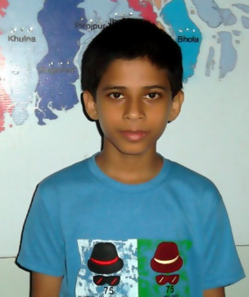
RANA GOES TO SCHOOL.
Chinmoy is the name of a boy .
Or,Chinmoy is the name of a parts of speech

Slide 6
DEFINITION OF PARTS OF SPEECH
Parts of speech: The words used in a sentence are called Parts of speech

Slide 7
OBJECTIVE
*After enjoying the picture Students can understand the subject matter.
*Ss can definition the parts of speech.
*Ss can classify the parts of speech.

Slide 8
Classifications of Parts of speech:
Noun
Pronoun
Adjective
Verb
Adverb
Preposition
Conjunctions
Interjection

Slide 9




Chimmoy
1.____ is a boy.
2. _ is going to school.
3.This flower is ---
4.Birds ____in the sky.
a
Chimmoy
He
red
fly

Slide 10
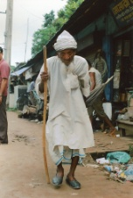
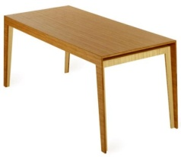
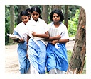

slowly
5.The old man walks_____.
6.The ball is __ the table.
7.Mina____Rina go to school.
.
8.Oh! I am______.
on
and
Mina Rina
undone

Slide 11
Students, I am making you in group. Find out the words and make a list of parts of speech.
She , go , fast , under , but ,hurra.black .Rana.on.read.simu.
GROUP WORK

Slide 12
EVALUATION
Match the following words with the pictures.

Slide 13
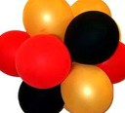
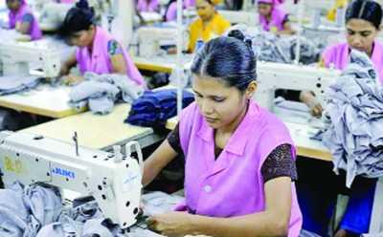
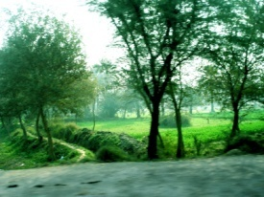
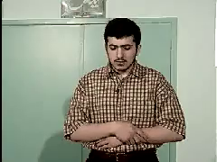

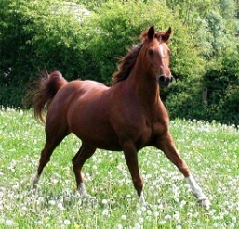
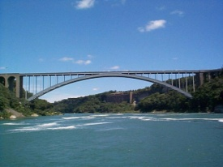
NOUN
PRONOUN
ADJECTIVE
VERB
ADVERB
PREPOSITION
CONJUNCTION
INTERJECTION
1
2
4
3
Mr.khan
6
5
8
7

Slide 14
HOME WORK
You will write eight sentences and under line parts of speeches here.

Slide 15
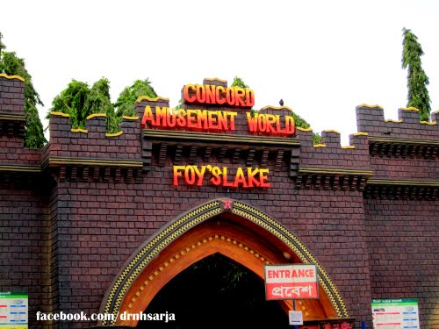
THANKS TO ALL

